Slide 1
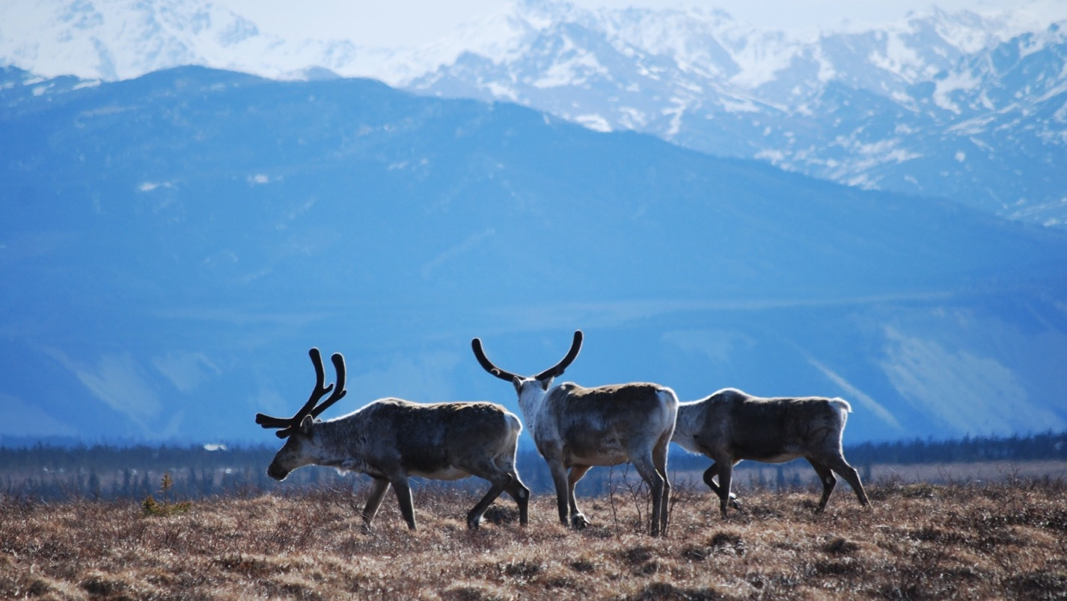
Arctic Boreal Vulnerability Experiment (ABoVE)
2019 ABoVE Airborne Flights
18 July 2019 (DOY 199)
AVIRIS-NG: Sortie 1: Daring Lake – Great Bear Lake
Sortie 2: Southern Great Slave Lake
Charles Miller, Deputy Science Lead
Jet Propulsion Laboratory, California Institute of Technology
and the ABoVE Science Team For Hank Margolis, Mike Falkowski, Bruce Tagg, Jack Kaye
NASA HQ
2019

Slide 2
18 July 2019/DOY 199 Daring Lake – Great Bear Lake/So. Great Slave Lake
Daily Status:
AVIRIS-NG / Dynamic Aviation B-200 (N53W)
REPORT DATE: 18 July 2019
Current Status of Aircraft: GREEN
Current Status of AVIRIS: GREEN
Current Deployment Location: Yellowknife NT (CYZF)
Crew: M Drowley (PIC), C McCann, M Helmlinger, L Rios
Science Planning: A Thorpe
Data Processing: W Olsen-Duvall
Instrument Manager: M Eastwood
Instrument PI: R Green
Science Lead: C Miller

Slide 3
18 July 2019/DOY 199 Daring Lake – Great Bear Lake/So. Great Slave Lake
Daily Summary:
Extreme clear across the Great Bear Lake – Great Slave Lake corridor
Sampling Daring Lake in advance of Townsend & Butman teams ground sampling in early August; First ABoVE sortie to Great Bear Lake area
Daring Lake – Encroaching front brings 10-20% cumulus interference to Daring Lake as AVIRIS approached – clear above; lines acquired despite clouds
Great Bear Lake – large cloud mass over eastern portion of GBL rules out Port Radium area, but Saw Mill Bay and lines to the east acquired; slight haze below but clear skies above the plane
Lines of Opportunity acquired during transits from Daring Lake to Great Bear Lake, and from Great Bear Lake back to Yellowknife

Slide 4
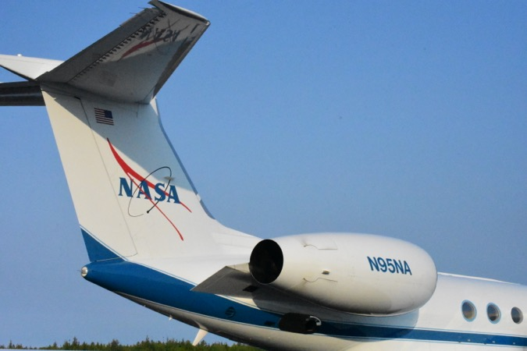
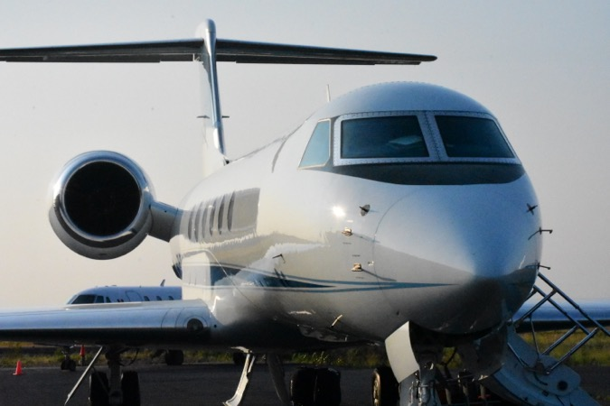
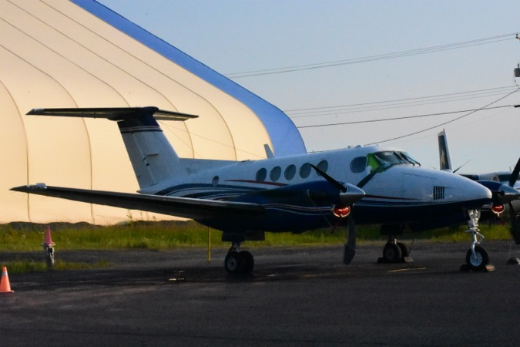
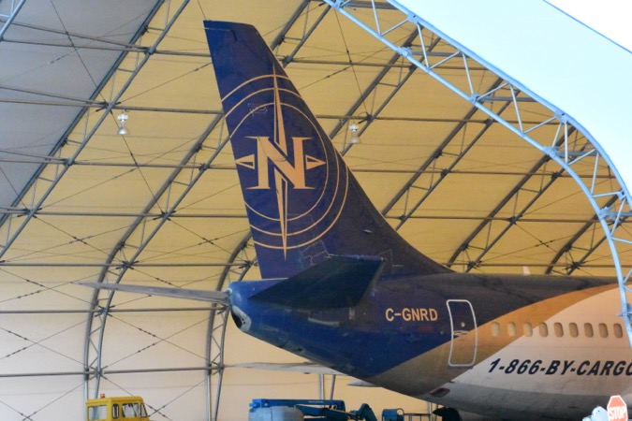
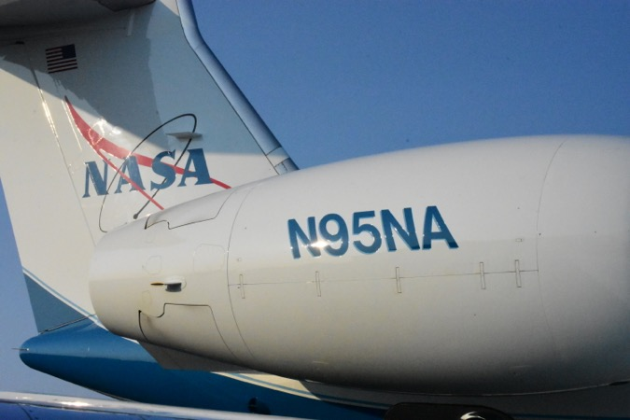
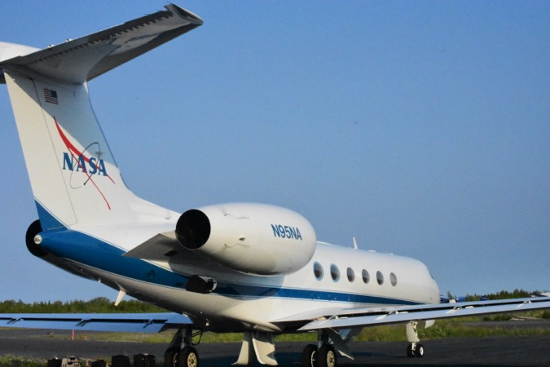
18 July 2019/DOY 199 Daring Lake – Great Bear Lake/So. Great Slave Lake
Notes:
AVIRIS & NEON teams in Barrow

Slide 5
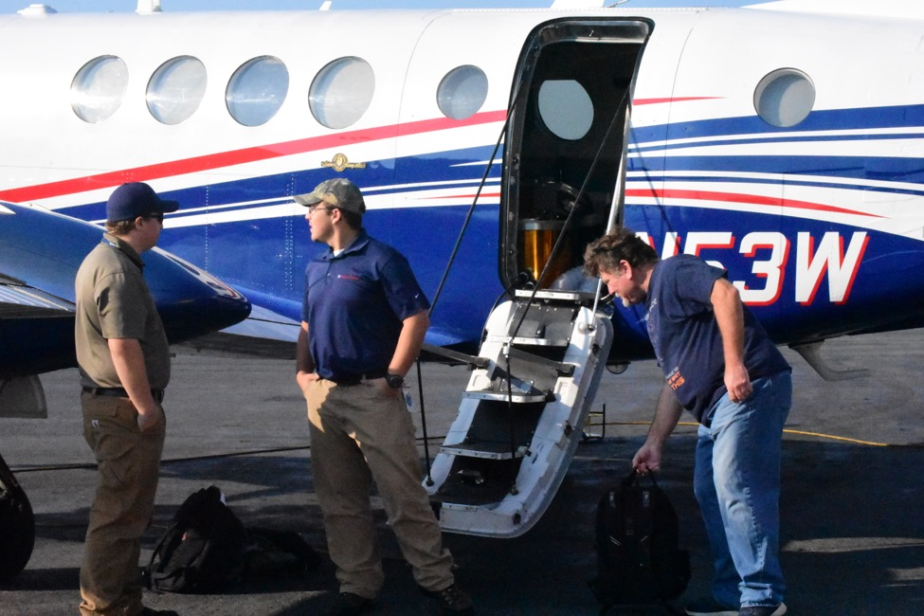
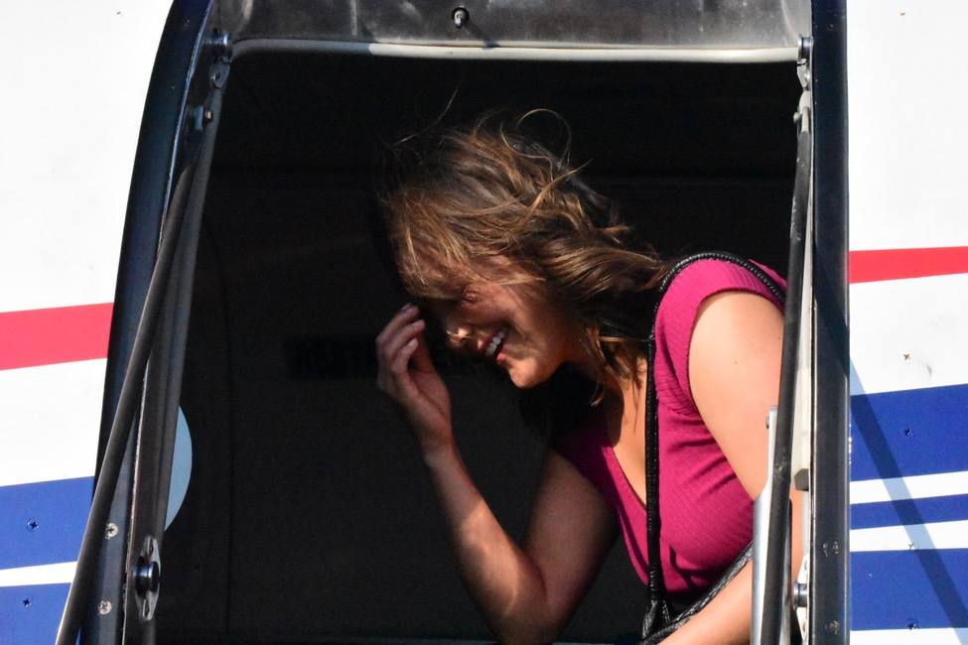
18 July 2019/DOY 199 Daring Lake – Great Bear Lake/So. Great Slave Lake

Slide 6
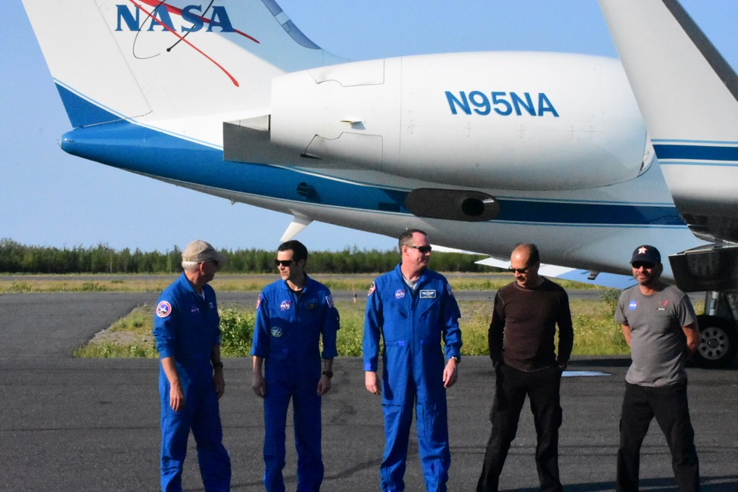
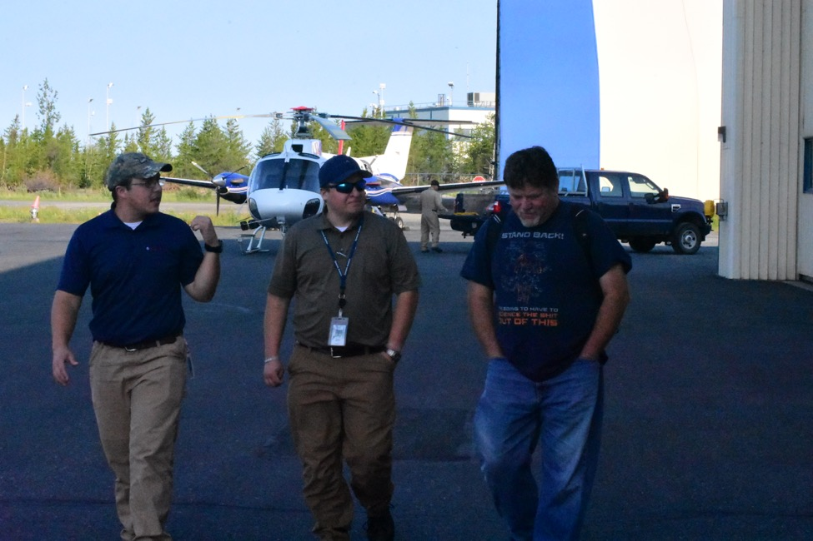
18 July 2019/DOY 199 Daring Lake – Great Bear Lake/So. Great Slave Lake

Slide 7
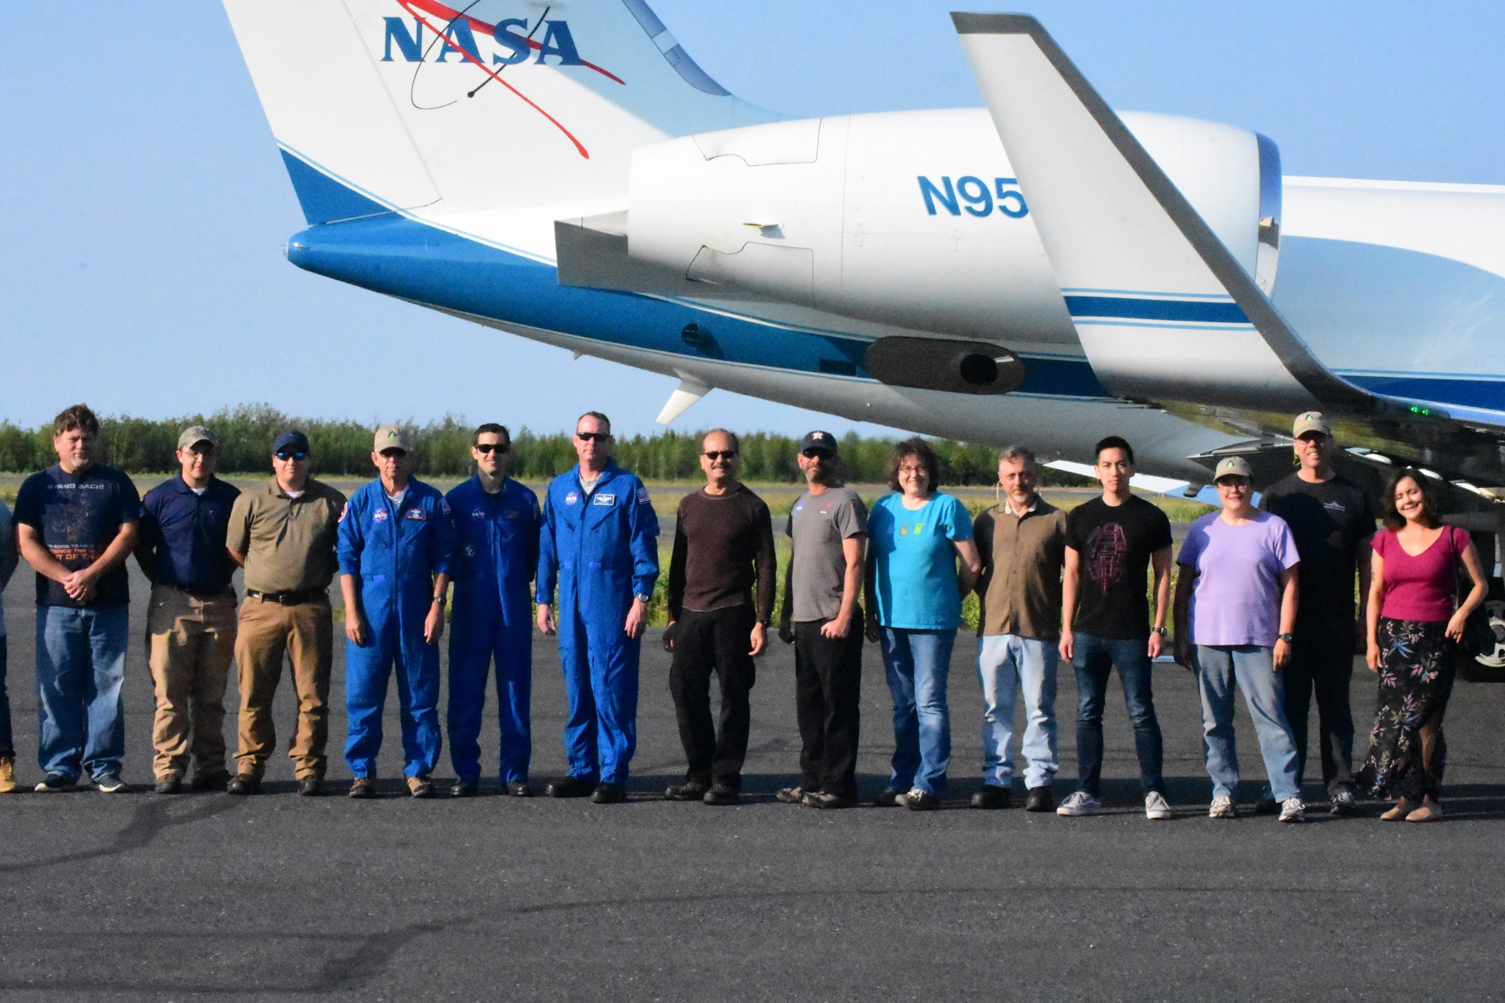

Slide 8
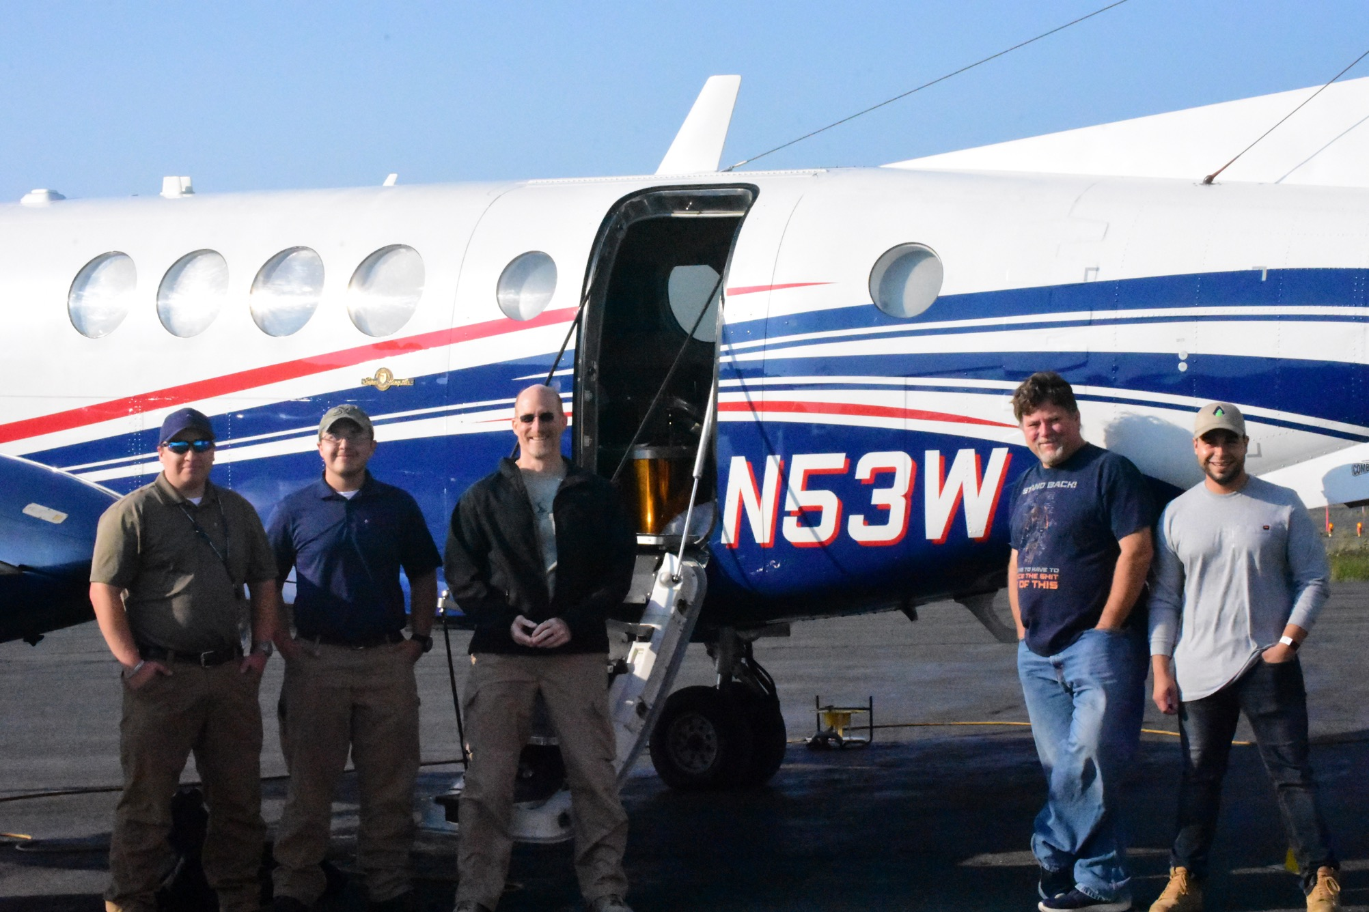

Slide 9
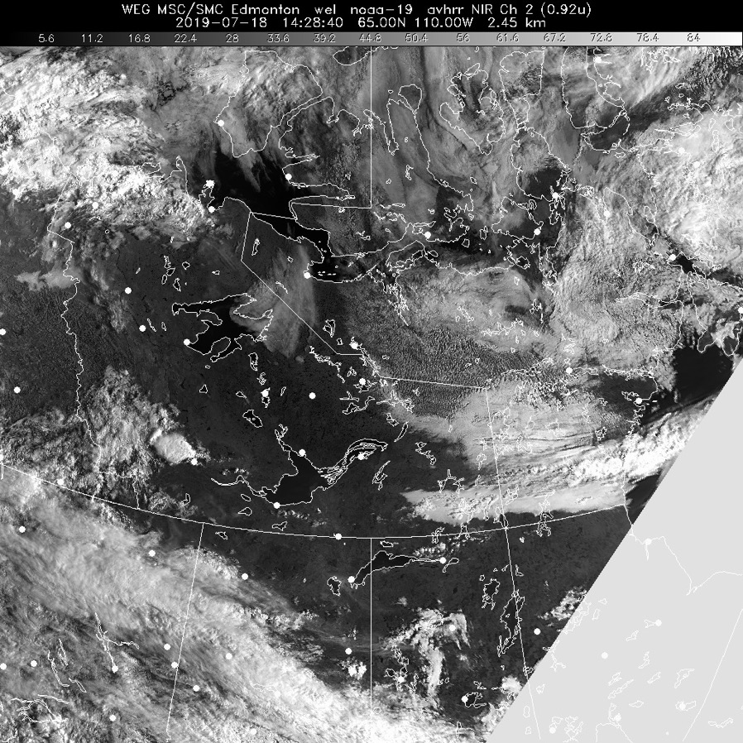
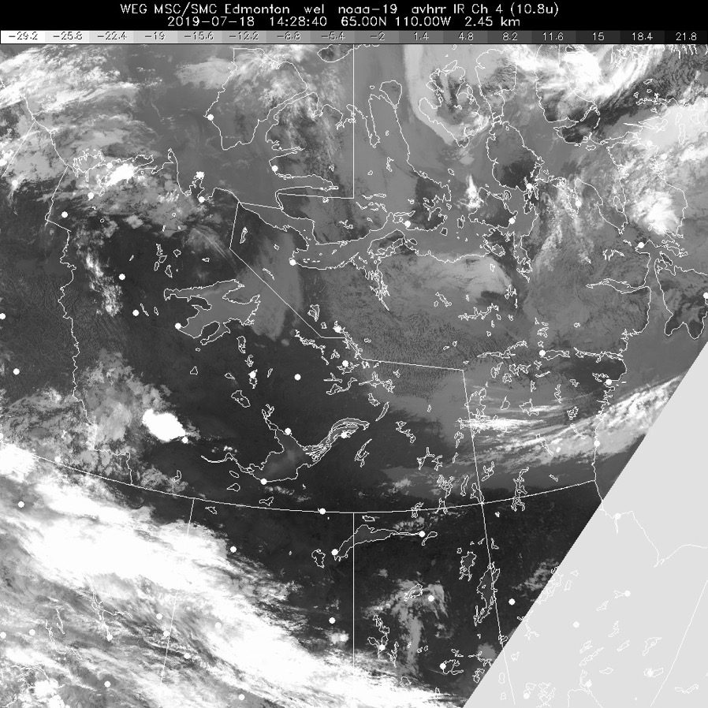
18 July 2019/DOY 199 Daring Lake – Great Bear Lake/So. Great Slave Lake
Vis 1428Z
IR 1428Z
Notes:
Cloud front encroaching on Daring Lake as AVIRIS arrives; increasing cumulus interference

Slide 10
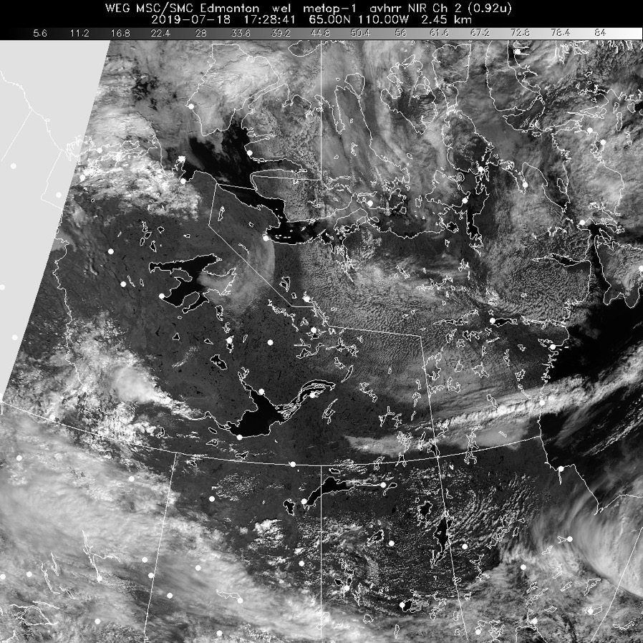
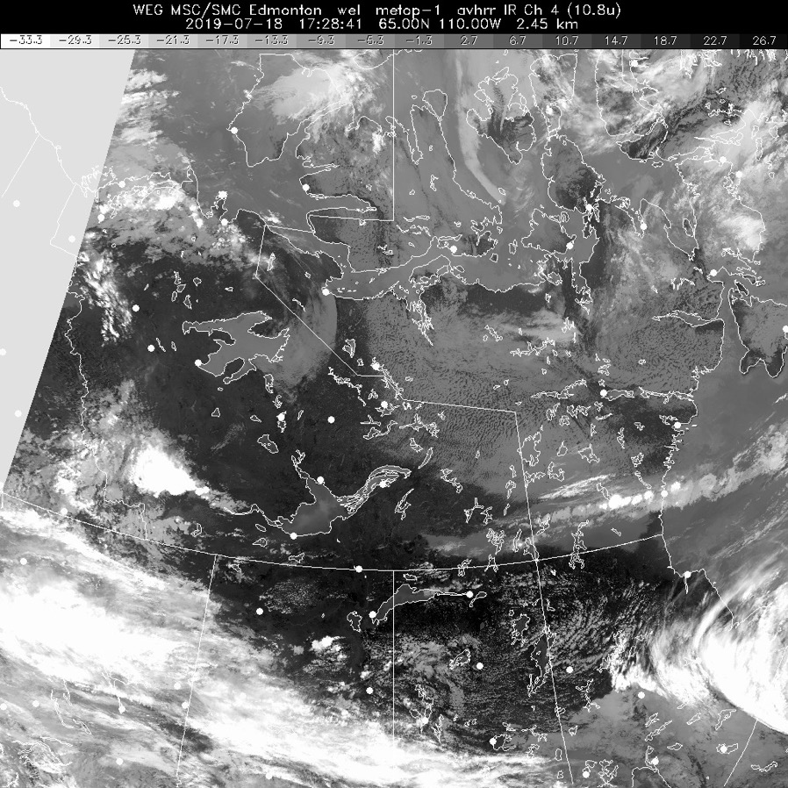
18 July 2019/DOY 199 Daring Lake – Great Bear Lake/So. Great Slave Lake
Vis 1728Z
IR 1728Z
Notes:
Large cloud bank on the eastern side of Great Bear Lake prohibits collections near Port Radium, but collecting data over Saw Mill Bay and points west

Slide 11
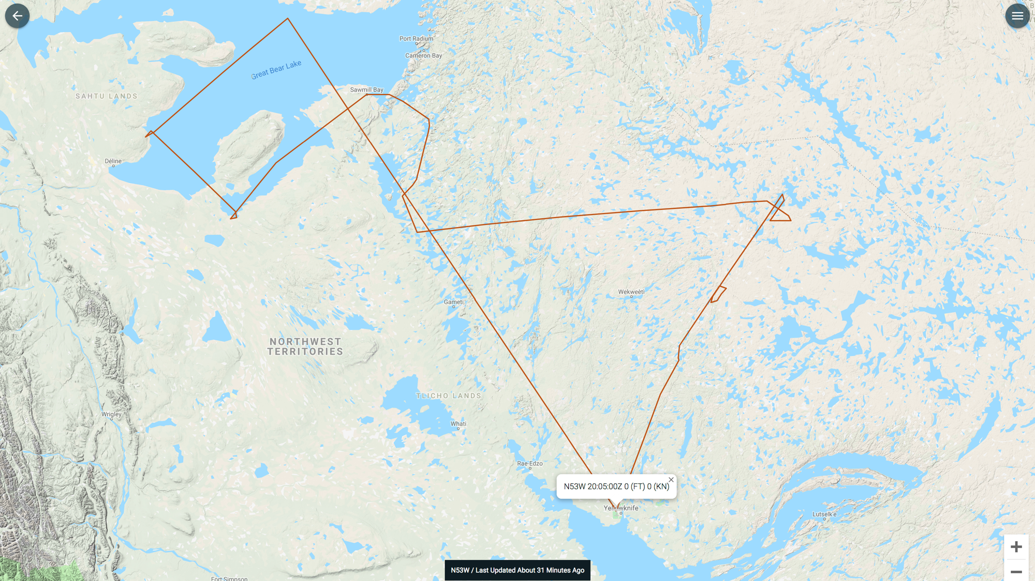
Sortie 1: As-Flown Lines
As-Flown Lines

Slide 12
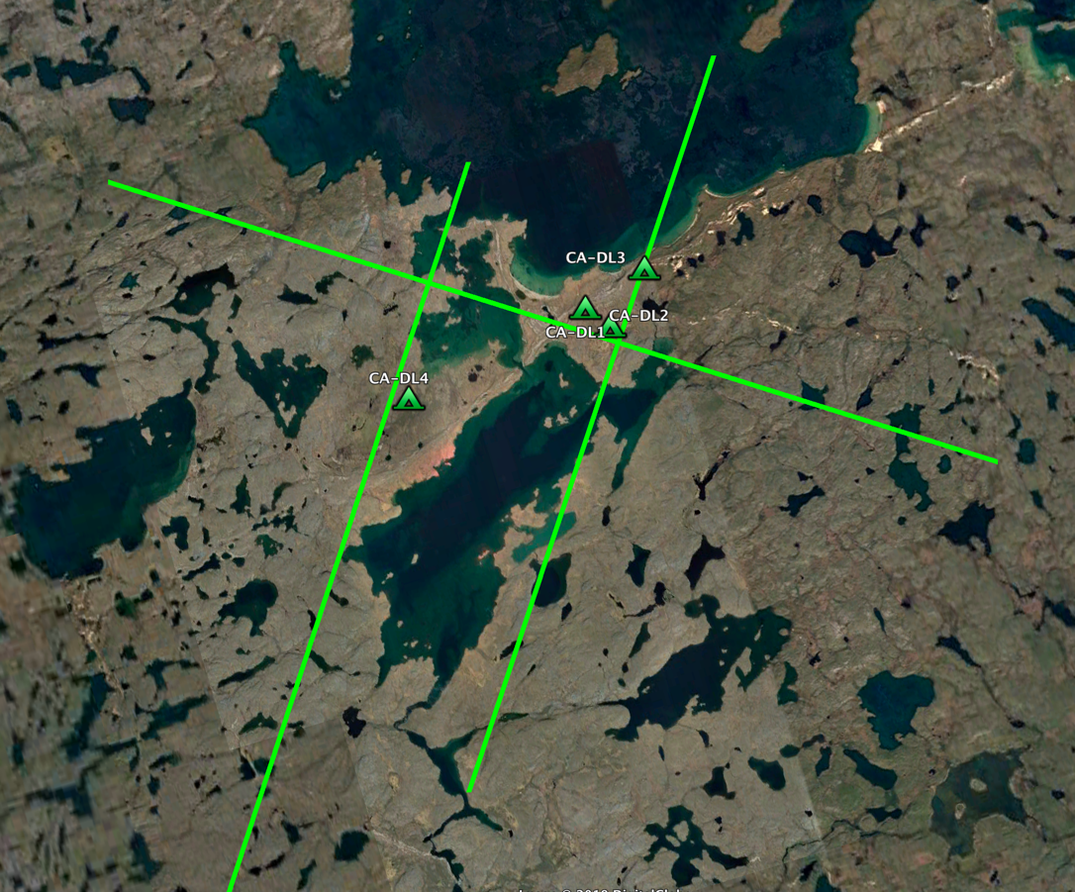
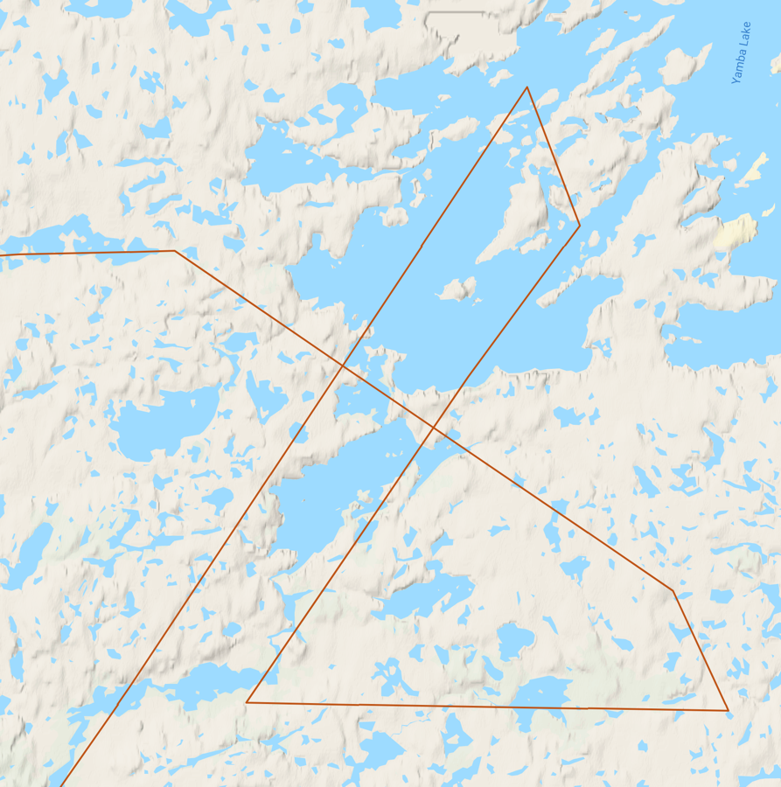
18 July 2019/DOY 199 Daring Lake – Great Bear Lake/So. Great Slave Lake
Daring Lake
Planned Flight Lines
Daring Lake
As-Flown Lines

Slide 13
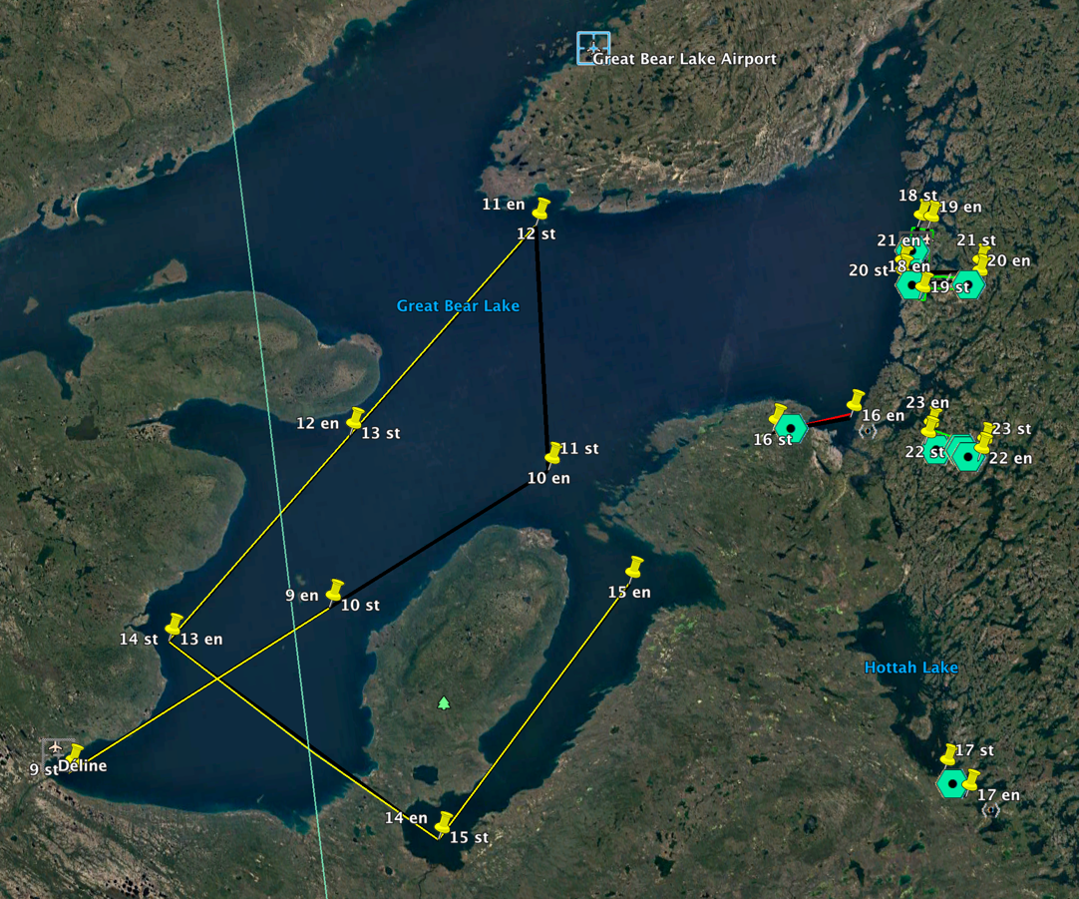
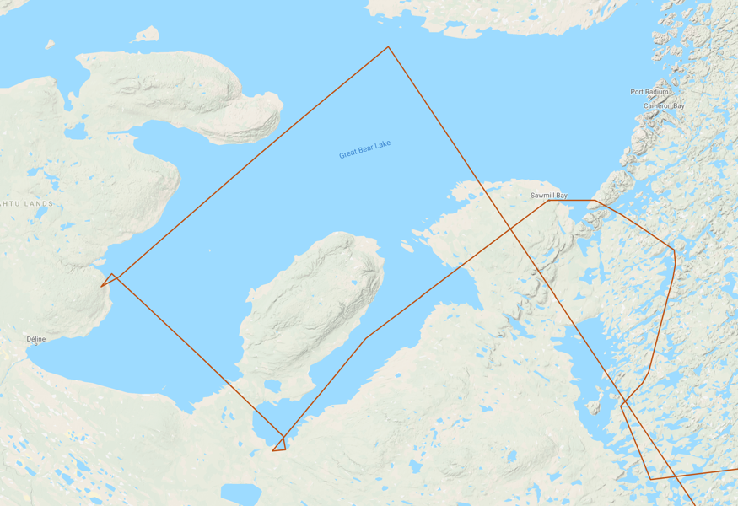
18 July 2019/DOY 199 Daring Lake – Great Bear Lake/So. Great Slave Lake
Great Bear Lake Area
Planned Flight Lines
Great Bear Lake Area
As-Flown Lines

Slide 14
18 July 2019/DOY 199 Daring Lake – Great Bear Lake/So. Great Slave Lake
Great Bear Lake Area
Planned Flight Lines
Great Bear Lake Area
As-Flown Lines
Update

Slide 15
18 July 2019/DOY 199 Daring Lake – Great Bear Lake/So. Great Slave Lake
AVIRIS-NG Quick-look products
https://avirisng.jpl.nasa.gov/cgi/flights.cgi?step=view_flightlog&flight_id=ang20180721t
A. Line 325A-D, FL183, Run ID 183446: Chalkyitsik – Porcupine River
B. Line 325A-D, FL183, Run ID 201426 : Chalkyitsik – Porcupine River - reverse
A
Update
B
A. A bit of fogging on lower edge of image
B. Popcorn clouds and orthorectification glitch near left edge

Slide 16
Backup

Slide 17
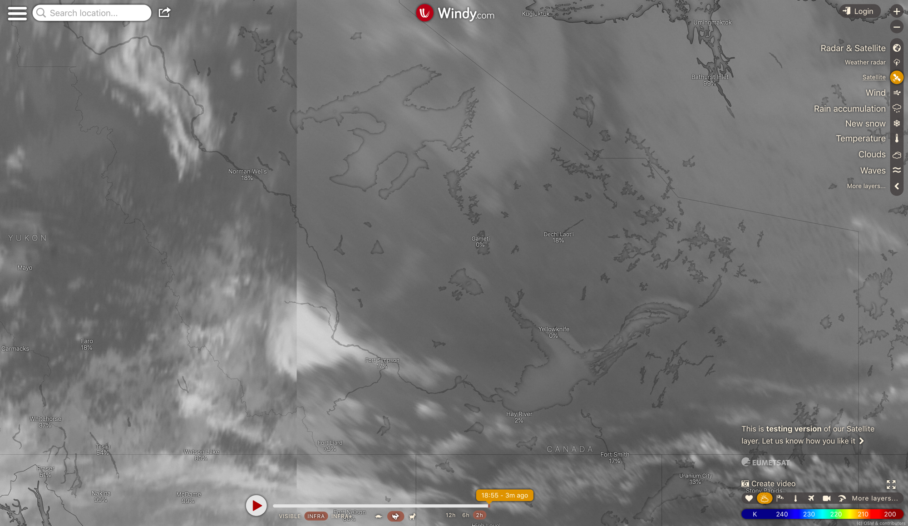
18 July 2019/DOY 199 Daring Lake – Great Bear Lake
Notes:
Windy screen shot from ~1900Z showing satellite cloud imagery over the Great Bear Lake – Great Slave Lake corridor.
Note the large cloud front obscuring eastern Great Bear Lake

Slide 18
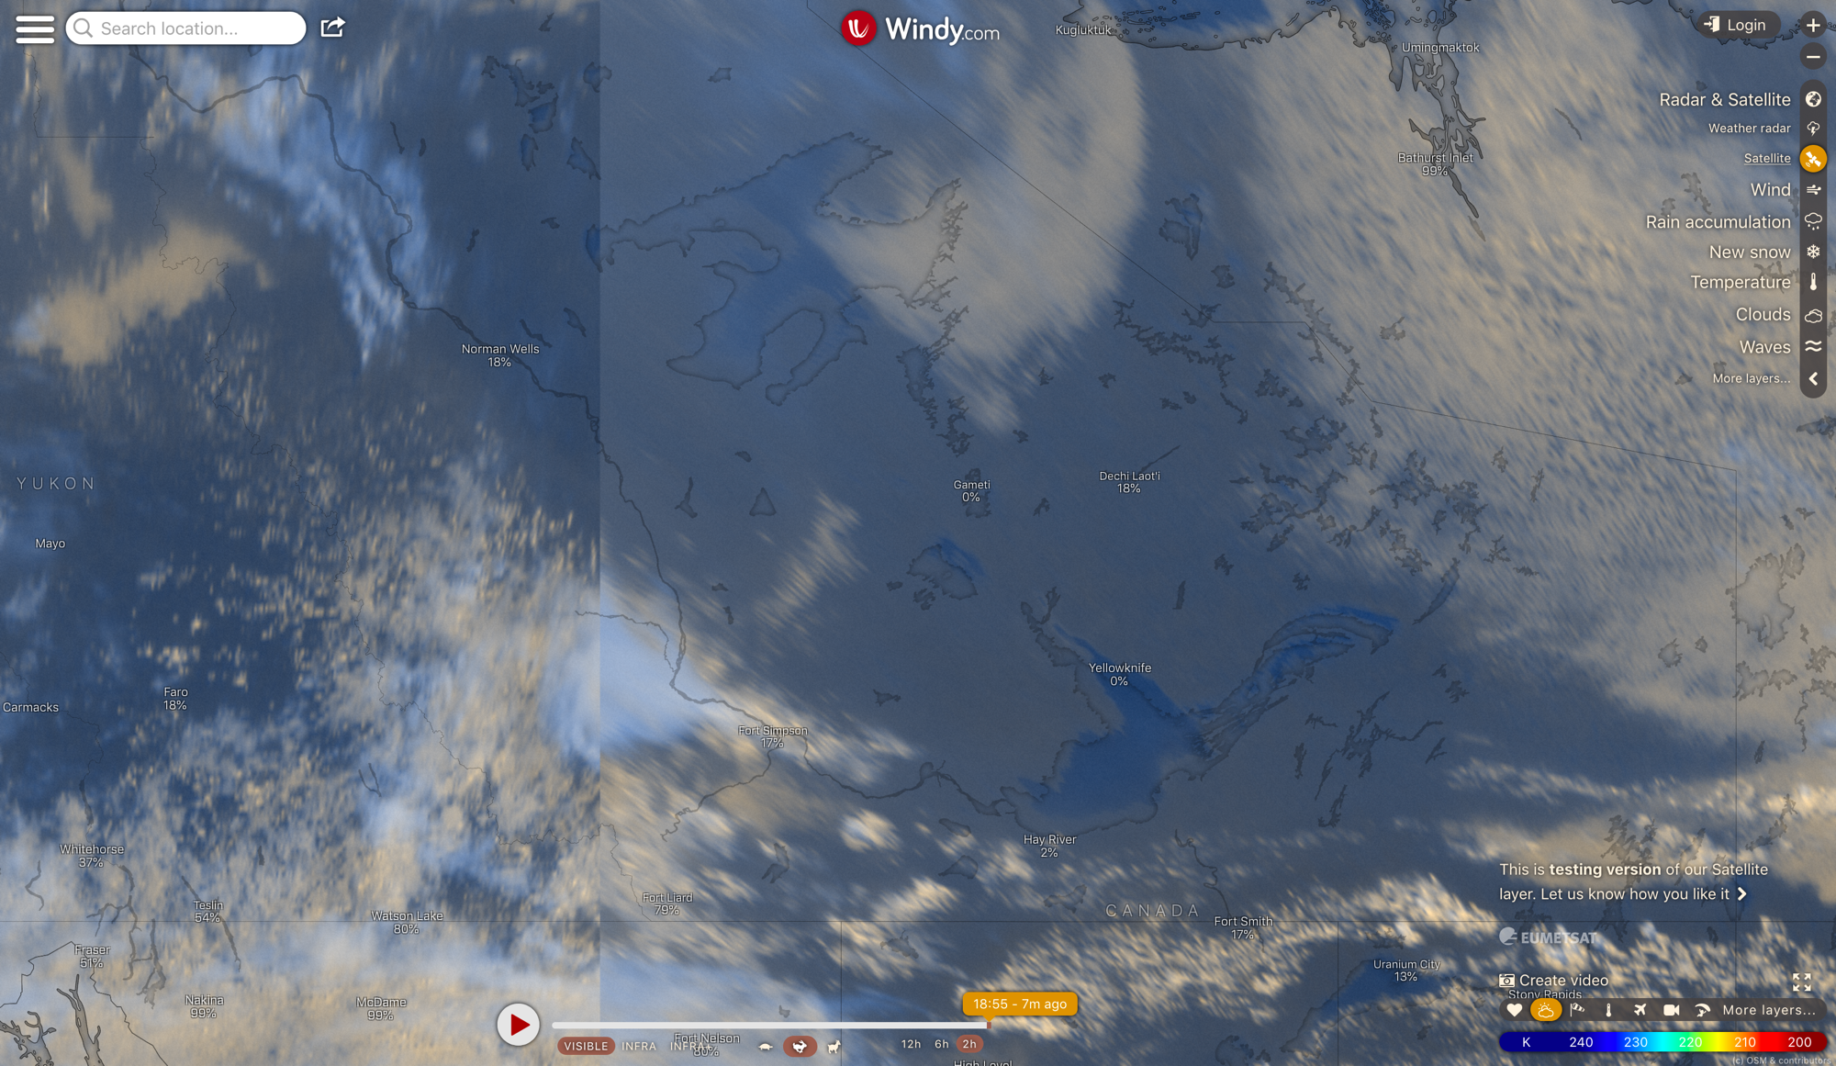
Notes:
Windy visible imagery circa 1900Z

Slide 19
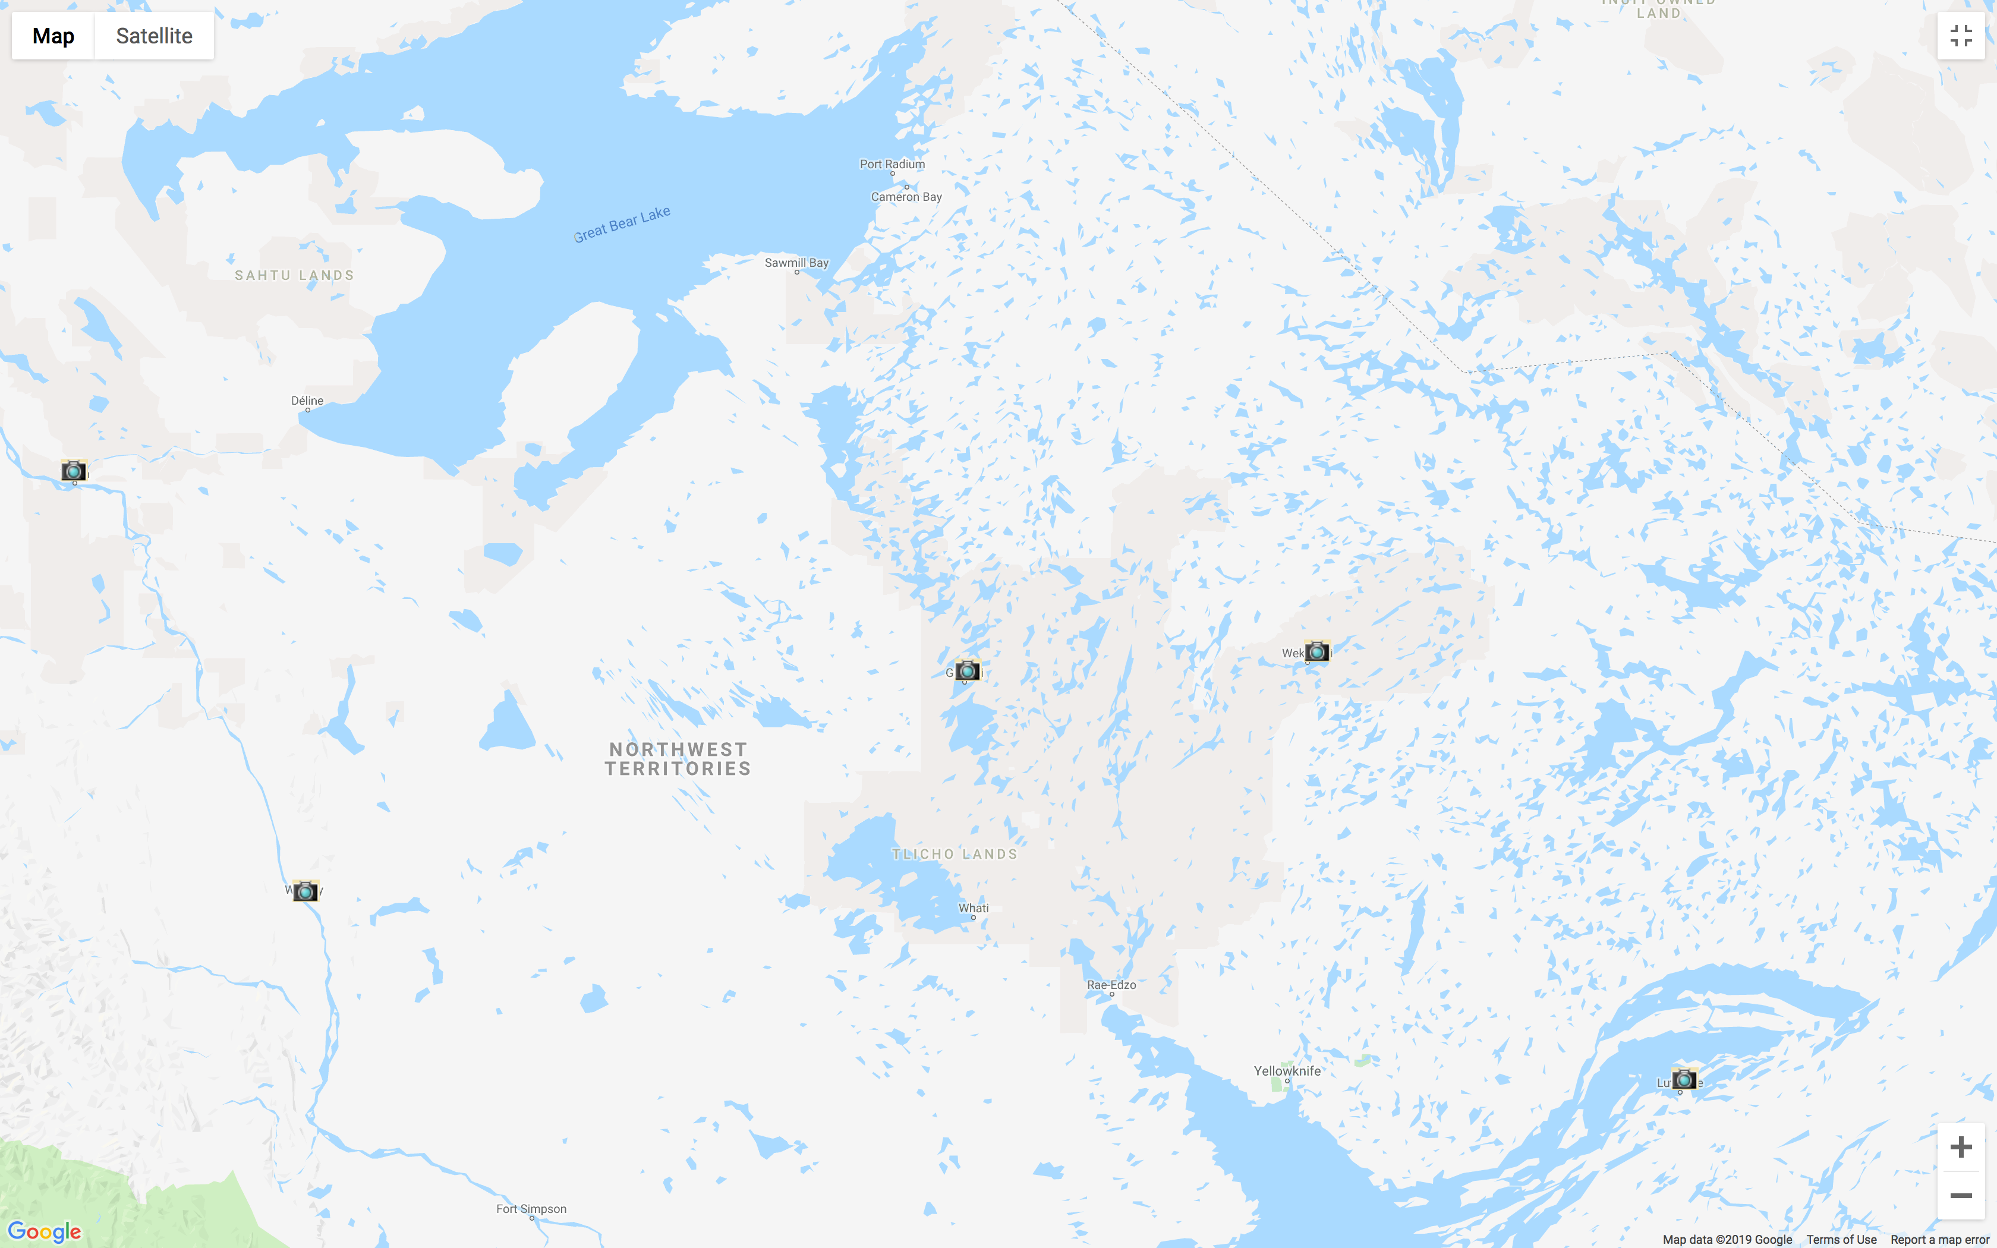
DWC
Camera Locations
Tulita
Gameti/
Rae Lakes
Wekweeti
Wrigley
Lutsel’ke

Slide 20
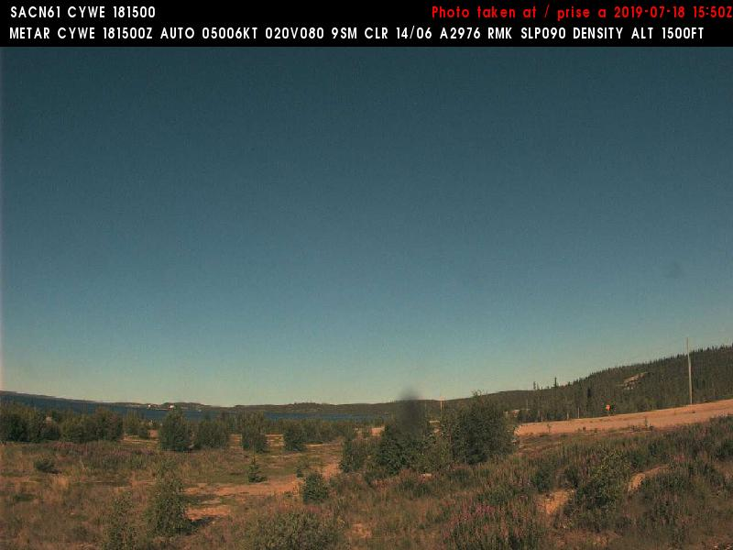
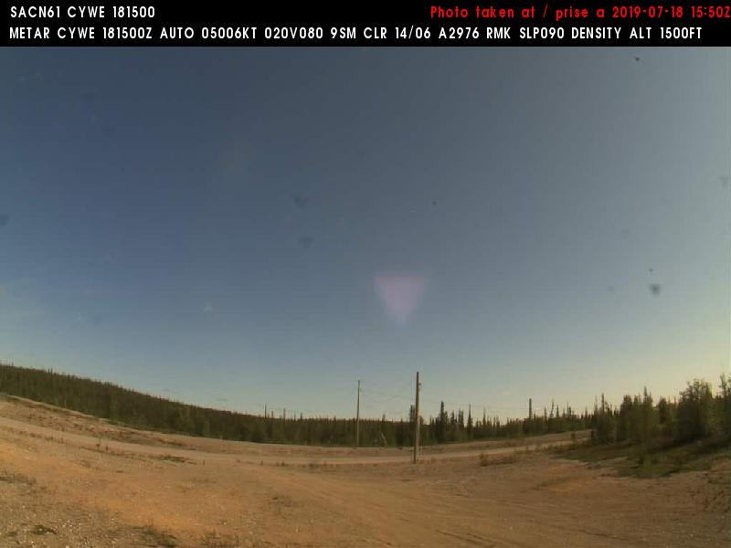
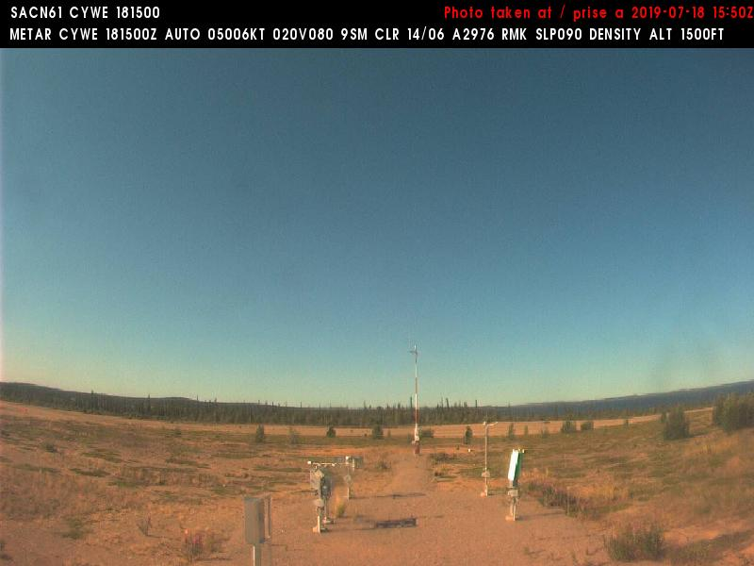
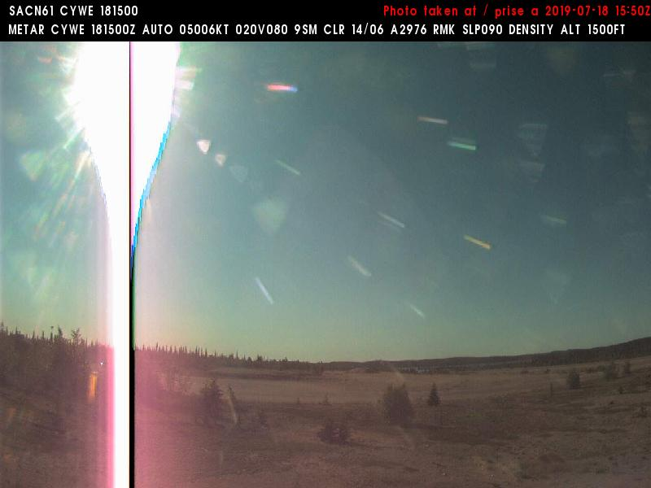
18 July 2019/DOY 199 Daring Lake – Great Bear Lake/So. Great Slave Lake
Wekweeti Airport (CYWE) N64 11 27 W114 04 36
0950 MDT/1550Z UTC
West
Northeast
Southwest
Southeast
Notes:
Taken during the time when AVIRIS approaching Daring Lake – where a cloud front is encroaching

Slide 21
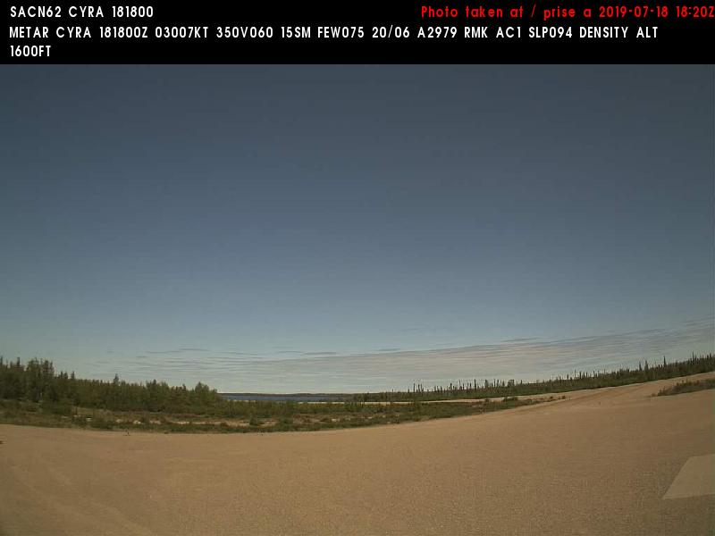
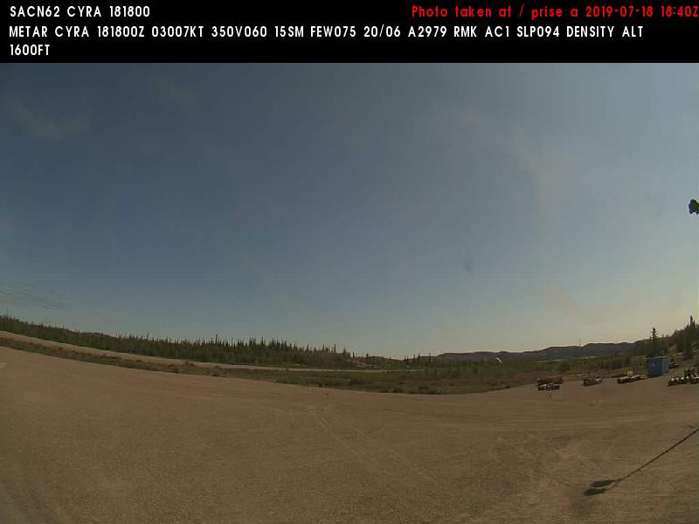
18 July 2019/DOY 199 Daring Lake – Great Bear Lake/So. Great Slave Lake
Gamètì/Rae Lakes (CYRA) N64 06 55 W117 18 48
1230 MDT/1830 UTC
North
East
Notes:
Recorded while AVIRIS acquiring Great Bear Lake lines

Slide 22
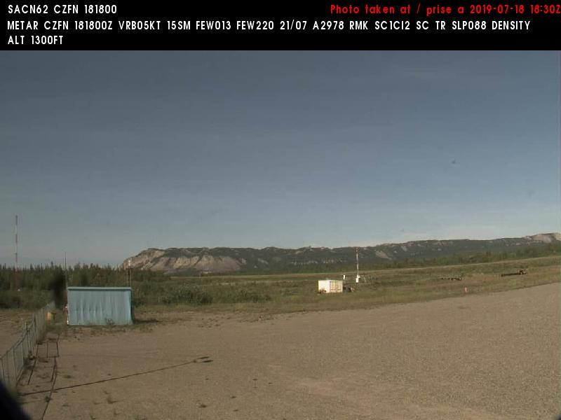
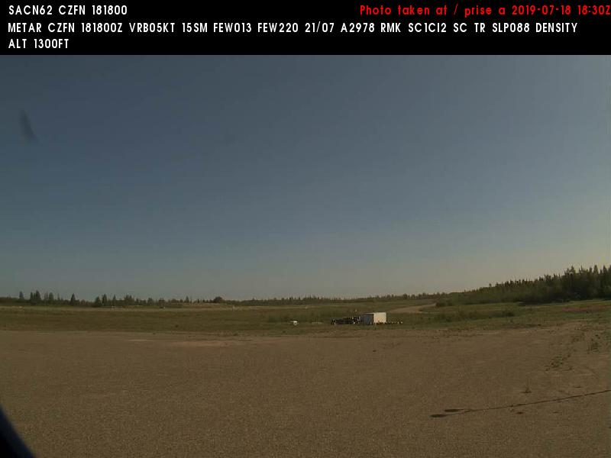
18 July 2019/DOY 199 Daring Lake – Great Bear Lake/So. Great Slave Lake
Tulita Airport (CZFN) N64 54 35 W125 34 10
1230 MDT/1830 UTC
West
Northeast
Notes:
Recorded while AVIRIS acquiring lines over eastern Great Bear Lake. Some haze moving in the the area, but mostly clear skies

Slide 23
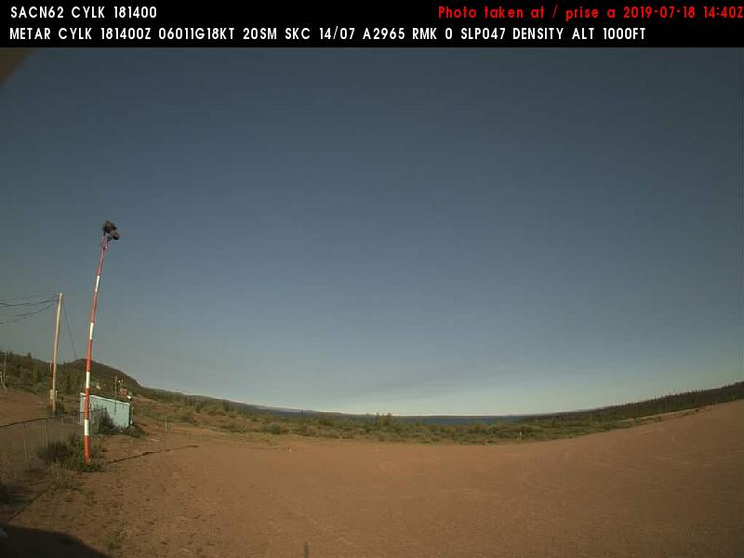
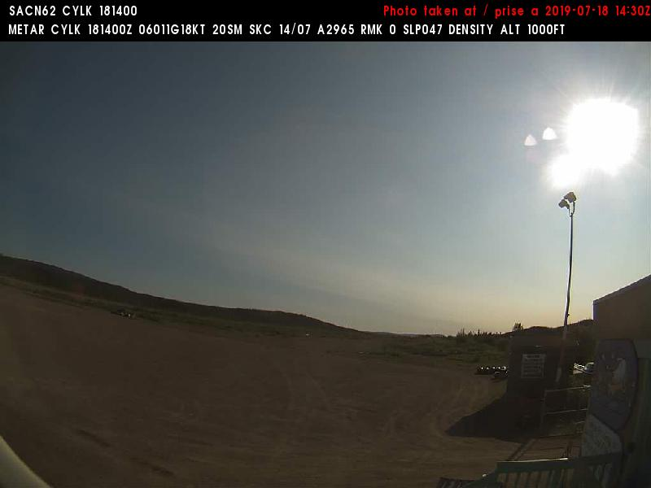
18 July 2019/DOY 199 Daring Lake – Great Bear Lake/So. Great Slave Lake
Lutselk'e (CYLK) N62 25 06 W110 40 56
0850 MDT/1450 UTC
West
Northeast
Notes:
Conditions near Yellowknife at start of Daring Lake transect

Slide 24
Sortie #2

Slide 25
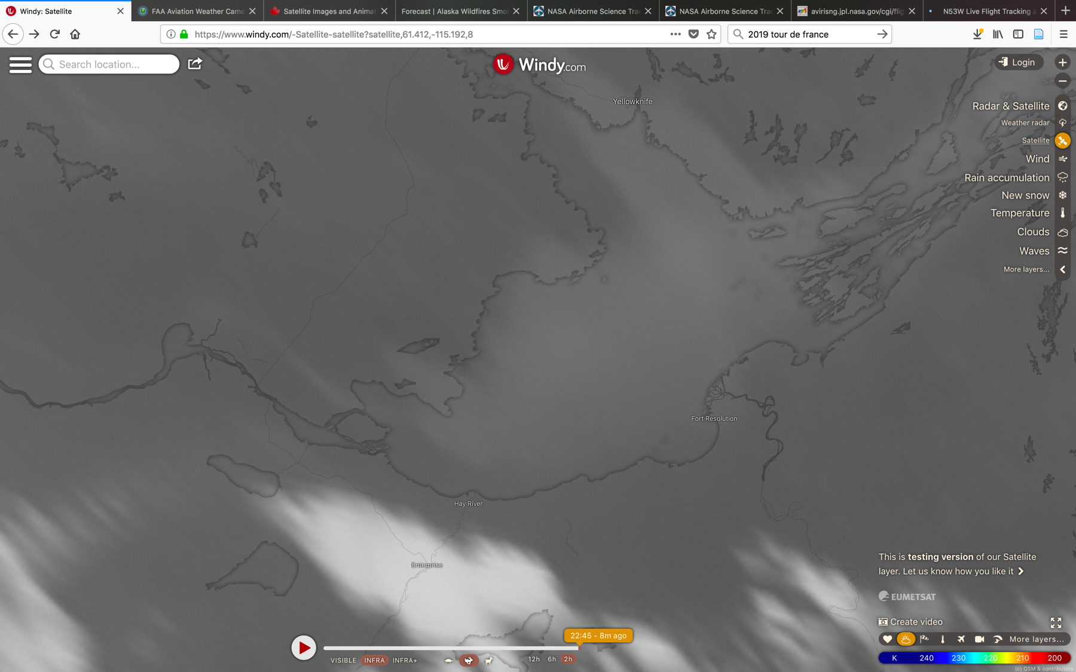

Slide 26
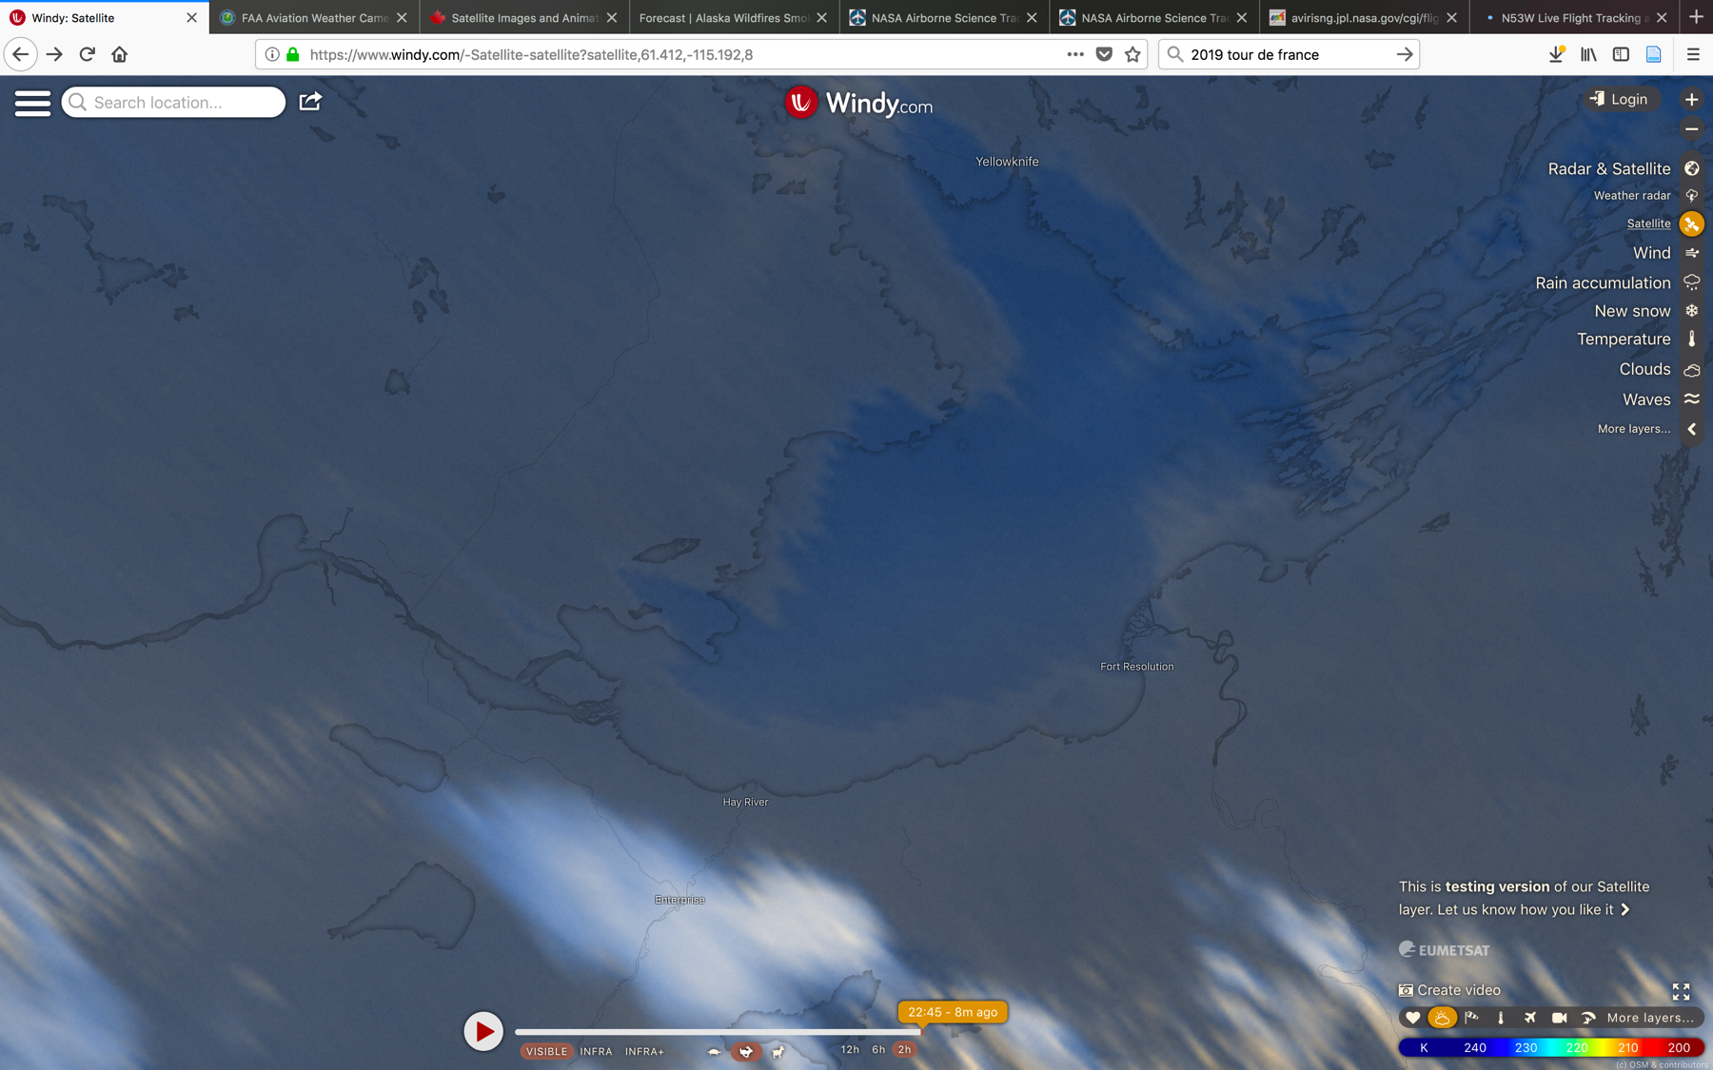

Slide 27
